Slide 1
INFO-3142
Modules and Scoping Rules

Slide 2
What is a Module?
A module is a file containing code
It defines a group of Python functions or other objects, and the name of the module is derived from the name of the file
Modules most often contain Python source code, but they can also be compiled C or C++ object files
Compiled modules and Python source modules are used the same way
Python uses namespaces

Slide 3
A First Module?
mymath.py
"""mymath - our example math module"""
pi = 3.14159
def area(r):
"""area(r): return the area of a circle with radius r."""
global pi
return(pi * r * r)

Slide 4
A First Module?
mymath.py
import mymath
#pi
#Traceback (innermost last):
# File "<stdin>", line 1, in ?
#NameError: name 'pi' is not defined
print(mymath.pi)
#3.14159
print(mymath.area(2))
#12.56636

Slide 5
A First Module?
mymath.py
print(mymath.__doc__)
#'mymath - our example math module'
print(mymath.area.__doc__)
#'area(r): return the area of a circle with radius r.'
from mymath import pi
print(pi)
#3.14159

Slide 6
A First Module?
mymath.py
#area(2)
#Traceback (innermost last):
# File "<stdin>", line 1, in ?
#NameError: name 'area' is not defined
import mymath, importlib
importlib.reload(mymath)
#<module 'mymath' from '/home/doc/quickpythonbook/code/mymath.py'>

Slide 7
The import Statement
The import statement takes three different forms:
import modulename
from modulename import name1, name2, name3, ...
From modulename import *

Slide 8
The module search path
Where Python looks for modules is defined in a variable called path, which you can access through a module called sys
import sys
print(sys.path)

Slide 9
The module search path
Where to place your own modules
Place your modules in one of the directories that Python normally searches for modules
Place all the modules used by a Python program in the same directory as the program (or subdirectory)
Create a directory (or directories) to hold your modules and modify the sys.path variable so that it includes this new directory (or directories)

Slide 10
Private Names in Modules
Use module import * to import almost all names from a module
The exception is that identifiers in the module beginning with an underscore can’t be imported with from module import *
People can write modules that are intended for importation with from module import * but still keep certain function or variables from being imported

Slide 11
Private Names in Modules
modtest.py
from modtest import *
print(f(3))
#3
#_g(3)
#Traceback (innermost last):
# File "<stdin>", line 1, in ?
#NameError: name '_g' is not defined
print(a)
#4

Slide 12
Private Names in Modules
modtest.py
#_b
#Traceback (innermost last):
# File "<stdin>", line 1, in ?
#NameError: name '_b' is not defined
import modtest
print(modtest._b)
#2
from modtest import _g
print(_g(5))
#5

Slide 13
Library and third-party modules
The standard Python distribution is split into modules to make it more manageable
After you’ve installed Python, all the functionality in these library modules is available to you
All that’s needed is to import the appropriate modules, functions, classes, and so forth explicitly, before you use them

Slide 14
Scoping Rules and namespaces
When a block of code is executed in Python, it has three namespaces: local, global, and built-in
When an identifier is encountered during execution, Python first looks in the local namespace for it
If the identifier isn’t found, the global namespace is looked in next
If the identifier still hasn’t been found, the built-in namespace is checked
If it doesn’t exist there, this situation is considered to be an error, and a NameError exception occurs

Slide 15
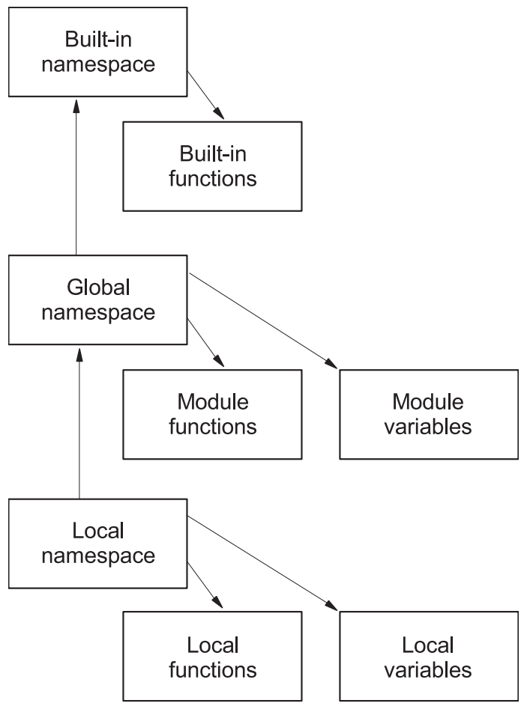
Scoping Rules and Namespaces

Slide 16
Scoping Rules and Namespaces
print(locals())
#{'__builtins__': <module 'builtins' (built-in)>, '__name__': '__main__',
#'__doc__': None, '__package__': None}
print(globals())
#{'__builtins__': <module 'builtins' (built-in)>, '__name__': '__main__',
#'__doc__': None, '__package__': None}>>>

Slide 17
Scoping Rules and Namespaces
z = 2
print(z)
import math
from cmath import cos
print(globals())
#{'cos': <built-in function cos>, '__builtins__': <module 'builtins'
#(built-in)>, '__package__': None, '__name__': '__main__', 'z': 2,
#'__doc__': None, 'math': <module 'math' from
#'/usr/local/lib/python3.0/libdynload/math.so'>}

Slide 18
Scoping Rules and Namespaces
print(locals())
#{'cos': <built-in function cos>, '__builtins__':
#<module 'builtins' (built-in)>, '__package__': None, '__name__':
#'__main__', 'z': 2, '__doc__': None, 'math': <module 'math' from
#'/usr/local/lib/python3.0/libdynload/math.so'>}

Slide 19
Scoping Rules and Namespaces
print(math.ceil(3.4))
#4
del z, math, cos
print(locals())
#{'__builtins__': <module 'builtins' (built-in)>, '__package__': None,
#'__name__': '__main__', '__doc__': None}
#print(math.ceil(3.4))
#Traceback (innermost last):
# File "<stdin>", line 1, in <module>
#NameError: math is not defined

Slide 20
Scoping Rules and Namespaces
def f(x):
print("global: ", globals())
print("Entry local: ", locals())
y = x
print("Exit local: ", locals())
z = 2
print(globals())
#{'f': <function f at 0xb7cbfeac>, '__builtins__': <module 'builtins'
#(built-in)>, '__package__': None, '__name__': '__main__', 'z': 2,
#'__doc__': None}

Slide 21
Scoping Rules and Namespaces
print(f(z))
#global: {'f': <function f at 0xb7cbfeac>, '__builtins__': <module
#'builtins' (built-in)>, '__package__': None, '__name__': '__main__',
#'z': 2, '__doc__': None}
#Entry local: {'x': 2}
#Exit local: {'y': 2, 'x': 2}

Slide 22
…More Scoping Rules and Namespaces
"""scopetest: our scope test module"""
v = 6
def f(x):
"""f: scope test function"""
print("global: ", list(globals().keys()))
print("entry local:", locals())
y = x
w = v
print("exit local:", locals().keys())

Slide 23
…More Scoping Rules and Namespaces
print(locals())
#{'__builtins__': <module 'builtins' (built-in)>, '__name__': '__main__',
#'__doc__': None, '__package__': None}
print(globals())
#{'__builtins__': <module 'builtins' (built-in)>, '__name__': '__main__',

Slide 24
…More Scoping Rules and Namespaces
import scopetest
z = 2
print(scopetest.f(z))
#global: ['__name__', '__doc__', '__package__', '__loader__', '__spec__', '__file__', '__cached__', '__builtins__', 'v', 'f']
#entry local: {'x': 2}
#exit local: dict_keys(['x', 'w', 'y'])

Slide 25
…More Scoping Rules and Namespaces
print(max.__doc__)
#max(iterable[, key=func]) -> value
#max(a, b, c, ...[, key=func]) -> value
#With a single iterable argument, return its largest item.
#With two or more arguments, return the largest argument.

Slide 26
…More Scoping Rules and Namespaces
print(list("Peyto Lake"))
#['P', 'e', 'y', 't', 'o', ' ', 'L', 'a', 'k', 'e']
list = [1, 3, 5, 7]
#print(list("Peyto Lake")) // error
#Traceback (innermost last):
# File "<stdin>", line 1, in ?
#TypeError: 'list' object is not callable

Slide 27
…More Scoping Rules and Namespaces
import mymath
mymath = mymath.area
#print(mymath.pi)
#Traceback (most recent call last):
# File "<stdin>", line 1, in <module>
#AttributeError: 'function' object has no attribute 'pi'
del list
print(list("Peyto Lake"))
#['P', 'e', 'y', 't', 'o', ' ', 'L', 'a', 'k', 'e']

Slide 28
…More Scoping Rules and Namespaces
import mymath
print(mymath.pi)
#3.14159
x1 = 6
xl = x1 - 2
print(x1)
#6
print(dir())
#['__annotations__', '__builtins__', '__doc__', '__loader__', '__name__', '__package__', '__spec__', 'x1', 'xl']

